Slide 1
BiomeTRIC VEHICLE ACCESS
Mandadi triveni
SAP ID : 51902794

Slide 2
Contents
Introduction
Why do we need more security?
Existing Security Techniques
Why Biometric
Types of Biometric
Architecture and Working
Advantages
Conclusion

Slide 3
Introduction
Derived from "BIOS" and "METRIC".
In this "Biometric vehicle access" system,it enables the person to control the vehicle using finger print.
Authorization is done only when the fingerprint matches with the record that is stored in the database.
Automated access monitoring system.

Slide 4


Slide 5
Why do we need more security ?
Longer distance range
Similar sounds of vehicles
Alarms can be disbled
Alarms can't be heard

Slide 6
Existing security techniques
Global Positioning System ( GPS )
Radio Frequency Identification ( RFI )
Engine Control Unit

Slide 7
WHY biometric ?
High Security
Verification
Auto Alarming
Unique Identification
Friction Ridges
GSM Module

Slide 8


Slide 9

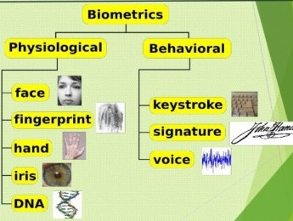
Types of biometric

Slide 10
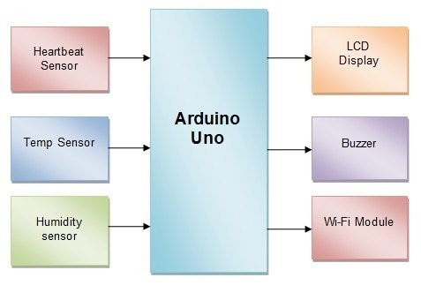
Architecture

Slide 11
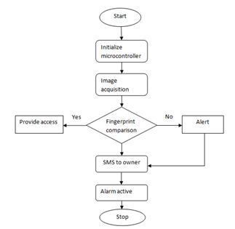
Working

Slide 12
Advantages
High End Protection
Storage
User Friendly
Alcohol Detection
Speed Detection
Easy Tracking
Low Maintenance Cost

Slide 13
Conclusion
It enhances the security of a vehicle and makes it possible only for seleted people to start the vehicle.
Thus, by implementing this, one can ensure much greater security than offered by a conventional lock and key.

Slide 14


